Slide 1







Partnering for Impact: Gainwell Technologies
and MO HealthNet
Chris Brown, RPh - Clinical Program Director
January 14th, 20th, and 21st.

Slide 2
Agenda
1
1
Introductions
2
2
Objective Statement
3
3
Where Are We?
4
4
What Is Next?
5
5
What Is Needed?
6
6
Questions?

Slide 3

Meeting Objectives
The purpose of this meeting is to review where we are, what has been accomplished, and to share next steps.
Key Objectives-
Ensure seamless transition for participants and providers at Go-Live.
Capture client intent while streamlining workflow and efficiency with Gainwell-specific innovation
Improve and streamline resource utilization/increase transparency

Slide 4

Where Are We?
4

Slide 5

How Requirement Met?
Requirements Validation Summary
Requirements
How Requirement Met(HRMs) are written by Gainwell to meet contractual requirements per Domain​
HRMs presented to Missouri Healthnet Division(MHD) during Requirement Verification Session(RVS) meetings. ​
Post MSD feedback, HRMs reworked and covered with MHD in Breakout Sessions
Requirement becomes Validated upon MHD team approval. ​
If a Breakout Session was needed, the Domain team reworked the HRM and presented to MHD. ​
Upon approval, HRM becomes validated. ​
​

Slide 6
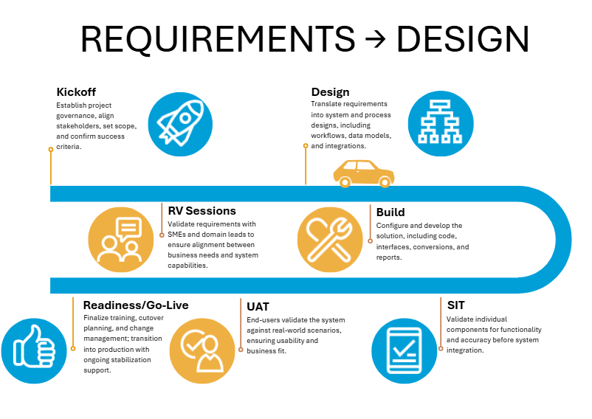
Project Life Cycle Update
With Requirement Verification Phase completed, we are now ready to transition to the Design Phase of the project.
Purpose: Move from confirming what the system must do (validated requirements) to defining how the system will complete it (design specifications).

Slide 7
What Is Next?
7

Slide 8
The Design Phase is a critical lifecycle stage with defined activities that keep us on track and ensure all required deliverables are met.
Design Sessions
Collaboration Meetings
Feedback Loops
“Successful design is making the right decisions early, documenting them clearly, and building what everyone agreed to.”

Slide 9
Design Phase:
Core Objectives
Clinical Rules
DUR Settings
Design Phase
Claims Edits
Ongoing review and approval of Clinical rules
Determine appropriate coding level to meet MHD intent
Configuration of clinical rules in the Gainwell system
MHD specific DUR Parameters and Severity decisions
Ongoing DUR edit configuration review
TDX crossovers and analysis of VUE-360-RxTDXManagement modules
Determine Claim Adjudication Rules
Identify Pricing Rules for FFS and MORx
Configure DUR modules
9

Slide 10
What Is Needed?
10

Slide 11

Provide Inputs
Success Dependencies
Successful design relies on the client providing complete inputs early, staying actively engaged in workshops and reviews, and giving timely, streamlined approvals so the team can finalize build-ready designs without delays or rework.
Streamlined Approval
Active Participation

Slide 12

Questions
Gainwell Technologies Proprietary and Confidential

