Slide 1
MANAGED CARE Helen Jaco, Director of Managed Care MO HealthNet Oversight Committee May 16, 2017

Slide 2
DSS Communication Efforts
Notes:
Individuals that have chosen to Opt Out of the Managed Care Program:
Prior to May 1st 1,045
On or After May 1st 1,286
Total MC Opt Outs 2,331

Slide 3
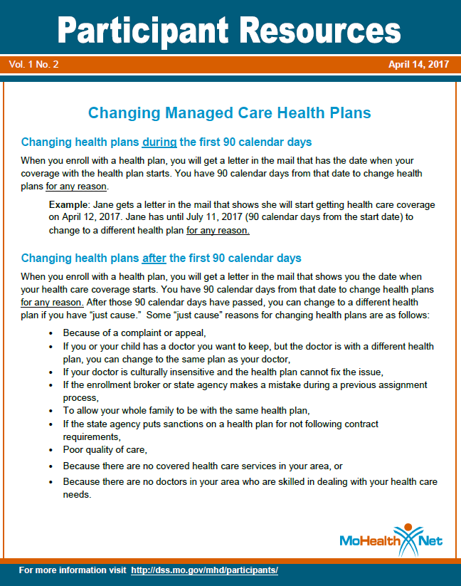
DSS Communication Efforts

Slide 4
Consumer Advisory Committee (CAC)
CAC began in 1995 at the inception of Managed Care
The CAC mission is to empower members to be actively involved in their healthcare
CAC is a vehicle for providing consumer input to the MO HealthNet Managed Care Program
CAC partnered to present a community meeting in Taneyville (30 attendees) in March 2017.
CAC intends to create and support local CACs throughout state led by consumer members
Notes:
The Consumer Advisory Committee (CAC) is a committee consisting of consumers who are Managed Care members, community partners, advocates, representatives of Legal Aid, health plan representatives, and other state agency representatives.
The CAC began in 1995 at the inception of Managed Care.
The mission of the CAC is to empower members to be actively involved in their healthcare. The CAC provides a vehicle for advising the Director of MO HealthNet on health care policy.
In March, 2017 the CAC partnered with the Taneyville School PTO, Cox Medical Center – Branson and the health plans to conduct a community meeting with MO HealthNet participants who were transitioning to Managed Care. About thirty moms, dads, grandmas and children attended.
State staff and consumers attended by WebEx and the health plan representatives attended in person and facilitated the meeting.
State staff presented information about the MO HealthNet Managed Care Program and the CAC consumer member talked about her experience in Managed Care and encouraged people to join the CAC.
Health Plan representatives staffed their own tables, responding to questions about their respective health plans and interacting with attendees.
Most questions:
Was their provider enrolled with the health plans?
Are their benefits the same as in FFS?
Is transportation still provided?
Can all of my children be enrolled with the same health plan?
New CAC structure
Intends to create and support local CACs throughout state led by consumer members
Will provide conduit for communicating the member experience unique to various regions of state

Slide 5
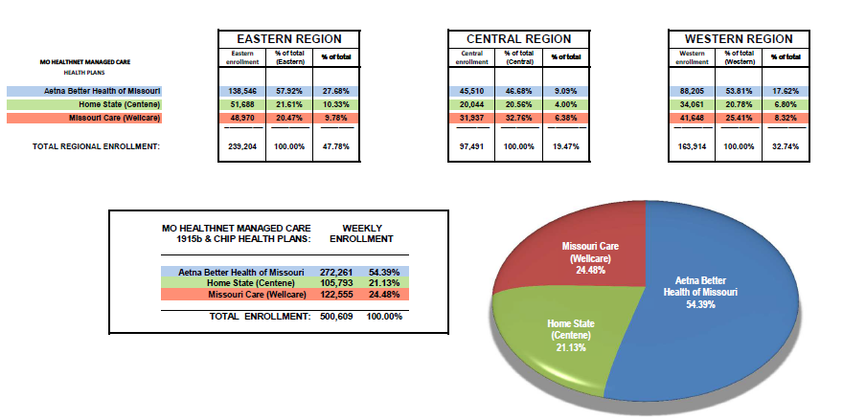
Market Share Report Prior to May 1st

Slide 6
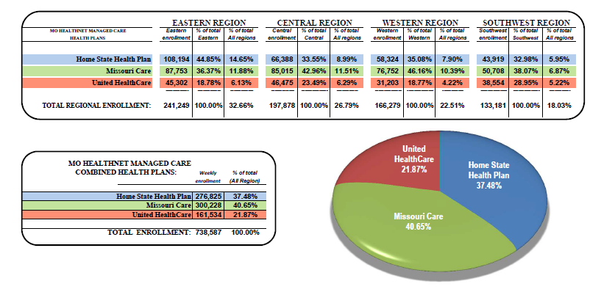
Current Market Share Report

Slide 7
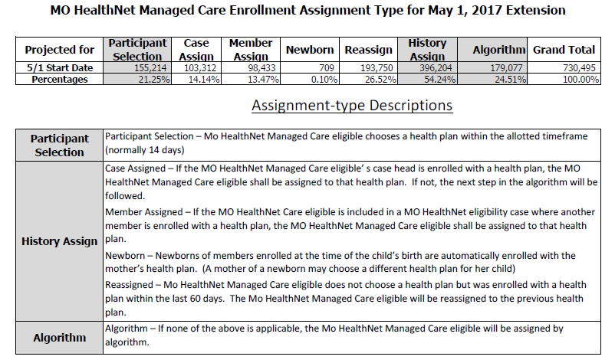
Enrollment Stats

Slide 8
Transition of Care
To ensure smooth transition of care for members during the extension of Managed Care Statewide the MO HealthNet Division conducted weekly conference calls in April and daily calls during the first two weeks in May with Missouri Care, United Healthcare, Home State Health, Aetna Better Health of Missouri and the MO HealthNet team (Managed Care, Evidence-Based Decision Support Unit, MMIS, Finance, Clinical Services, etc.)
Daily conference calls were conducted with Missouri Care, United Healthcare & Home State Health during the first two weeks in May.
May 8th – Truman State Holiday – Offices remained opened
Enrollment Broker
Participant Services
Managed Care Health Plans
Managed Care Unit

Slide 9
Inquires Regarding May 1st Extension
Participants
How do I change my doctor?
How do I change my Managed Care Health Plan?
What are the benefits included in Managed Care?
How do I update the authorized representative on file?
Providers
Who is eligible for Managed Care?
How to enroll as a Managed Care provider?
How long does it take to be credentialed with the Managed Care Health Plans?
What happens if I am not contracted with a Managed Care Health Plan, how do I get reimbursed for services provided?
Behavioral Health coverage

Slide 10
Additional Benefits – Missouri Care
After School Clubs Program
Child Birth & Breastfeeding Classes
Diabetes Camp
Diabetic Foot Care
Electric Breast Pump
Maternity Program
Visual Impairment Camp
Maternity Support Hose & Support Belts
Peak Flow Meters Program
Enhanced Transportation Program
Curve Complete Program
Weight Watchers Program

Slide 11
Additional Benefits – United HealthCare
Hypoallergenic Assistance
Chiropractic
JOIN for ME
On My Way
Youth Membership Program
Airwaze
Peer Support Specialist

Slide 12
Additional Benefits – Home State Health
After School Youth Program
Baby Shower for Moms
Enhanced & Same Day Transportation
Mobile Texting & ConnectionsPlus Phone Program
Puffletown

