Slide 1
THE CCBHC Prospective Payment System Demonstration Project
The views, opinions, and content expressed in this presentation do not necessarily reflect the views, opinions, or policies of the Center for Mental Health Services (CMHS), the Substance Abuse and Mental Health Services Administration (SAMHSA), or the U.S. Department of Health and Human Services (HHS).

Slide 2
What is the Demonstration Project and why is it important?
A Variety of Names
The Excellence in Mental Health Act (EMH Act)
  Co-sponsored by Senator Blunt
The Protecting Access to Medicare Act of 2014 (PAMA)
  Section 223: Demonstration Programs to Improve Community Mental Health Services
The CCBHC PPS Demonstration Project
Notes:
Senator Blunt, introduced legislation entitled the” Excellence in Mental Health Act” designed to establish and support a national system of community behavioral health organizations meeting new comprehensive federal standards based on all that has been learned since the 1960s in the effective treatment and support of individuals affected by mental health and substance use disorders.
As is typical in the legislative process, Senator’s Blunt bill was incorporated as Section 223 of a much larger bill, the Protecting Access to Medicare Act of 2014 (PAMA), and recast as a Demonstration Program designed to pilot establishment of community behavioral health organizations meeting new comprehensive federal standards, and to also pilot a Medicaid Prospective Payment System as the means of federal support for such organizations.
As you can see, Section223 was titled “Demonstration Programs to Improve Community Mental Health Services”.
But for reasons which will become obvious shortly, we refer to this as the “CCBHC PPS Demonstration Project.”

Slide 3
What is the Demonstration Project and why is it important?
The Federal Requirements
Section 223 of the Act authorizes CMS/SAMHSA to
  Pilot a Medicaid Prospective Payment System (PPS) for mental health services provided by certified Community Behavioral Health Clinics (CCBHCs) for two years, in no more than eight states.
  Award planning grants to assist states in preparing to apply to participate in the demonstration project.
  Requires a national evaluation of the demonstration
Notes:
Section 223 authorized the federal Substance Abuse and Mental Health Services Administration (SAMHSA) and the federal Centers for Medicaid and Medicare (CMS), to work together to oversee the Demonstration Program.
SAMHSA was charged with establishing national standards for organizations to be known as Certified Community Behavioral Health Clinics, or CCBHCs. CMS was charged with establishing guidelines for a Prospective Payment System for CCBHCs serving Medicaid clients.
The legislation authorized SAMHSA and CMS to select 8 states to participate in a two-year demonstration, but authorized planning grants to a broader number of states in recognition that states would be required to do a significant amount of work to determine which organizations in the states could meet the new standards ,as well as whether and how the state could create a prospective payment system.
Twenty-four states applied for and received planning grants. Last October, having spent a year and half preparing, twenty states applied to participate in the Demonstration. Last December, we were one of the 8 states chosen to participate. The other states are Minnesota, New Jersey, New York, Pennsylvania, Oklahoma, Oregon, and Nevada.
Section 223 also requires a national evaluation of the Demonstration Project.

Slide 4
What is the Demonstration Project and why is it important?
The Federal Requirements
  Section 223 of the Act
    Authorizes CMS to reimburse the selected states at an enhanced Medicaid match rate
    Though not mentioned in the statute, CMS/SAMHSA have given states the option to implement a form of Pay-for-Performance as part of the Demonstration Project
  Timeline
    July 1, 2017 through June 30, 2019
Notes:
The 8 participating states will receive an enhanced Medicaid match rate during the Demonstration Project. Match rates vary by state. Typically, in Missouri, the federal government pays about 65 cents and the state pays about 35cents of every Medicaid dollar. During the Demonstration Project, the federal government will pay about 76 cents of every Medicaid dollar spent on CCBHC services provided to Medicaid clients. This means that about 11 cents per dollar of state funding previously spent on CCBHC services to Medicaid clients will be freed up for other purposes during the Demonstration Project. Because this enhanced match rate only lasts during the Demonstration period, these funds are only freed up for two years. Therefore the State must be careful about how it utilizes the resources that have been freed up. This spring the Governor and General Assembly will determine how the freed up funds are to be used. We are hopeful that at least a portion of these funds will be used to expand community behavioral health services.
Though the legislation did not mention it, the participating states have been given the option to implement a form of pay-for-performance reimbursement, known as a Quality Bonus Payment or QBP, as part of the Demonstration Project. Missouri has chosen to implement a QBP, and I will explain what that means and how it works later in the presentation.
The two-year Demonstration Project will begin on July 1st and run through June 30, 2019.

Slide 5
What is the Demonstration Project and why is it important?
Why Is This Important?
It establishes a place for community behavioral health organizations in federal statute.
It establishes national standards for organizations providing community behavioral health services.
It provides an opportunity to implement cost based reimbursement
It has the potential to assist in expanding the array of services, improving access to care, and increasing the quality of care
Notes:
As we have seen although President Kennedy’s Community Mental Health Centers Act provided funding to establish CMHCs that met federal standards, once CMHC grants were eliminated , the place of community behavioral health organizations began to erode to the point where today the term “CMHC” no longer occurs in federal statute. As a consequence, there is no vehicle at the federal level to support the development and growth of community behavioral health services beyond the very limited resources associated with the block grants to the states, which themselves no longer target specific community behavioral health organizations. Consequently, the demonstration is important because it re-establishes a vehicle for federal support for organizations like ours.
It is also important because it establishes new national standards for community behavioral health organizations that will, ultimately, assure that regardless of where they live, all Americans can expect to receive a comprehensive array of behavioral health services and supports that embody best practices.
As we will see, the Prospective Payment System that will be piloted under the Demonstration Project is a cost-based reimbursement system. This means that the reimbursement organizations receive will be more closely tied to the actual cost of providing services.
Finally, as well see, the demonstration project has the potential to expand the array of services while improving the access to, and quality of, care.

Slide 6
What is the Demonstration Project and why is it important?
State Responsibilities
Based on an assessment of need, establish
  Populations of focus
  Required services and staffing
  Required evidenced-based, promising and best practices
Based on SAMHSA certification criteria, designate Certified Community Behavioral Health Clinics
Based on CMS guidelines, establish a Prospective Payment System for CCBHCs
Based on SAMHSA reporting requirements, collect and report outcomes efficiency, effectiveness and health status
Notes:
Under the Demonstration Project, SAMHSA provided criteria for recognizing CCBHCS and established specific reporting requirements, and CMS provided guidelines for establishing the Prospective Payment System. But the State had the flexibility to establish populations of focus, and services, staffing, and evidenced based requirements based on a State needs assessment, so long as the state standards were consistent with the general SAMHSA standards.

Slide 7
What is a CCBHC?

Slide 8
What is a CCBHC?
The CCBHC Paradigm
A non-profit or governmental organization
Serving a specific geographic area
Employing evidence-based, best and promising practices
Coordinating care and providing a comprehensive array of community behavioral health services
To the residents of the area and specific populations of focus
Regardless of their ability to pay
Across the lifespan: children, adolescents and adults
Measuring and reporting specific outcomes regarding efficiency, effectiveness and health status
Notes:
This slide says it all. A CCBHC is….[Simply read this slide.]
[Then say:] This obviously describes who we are, or at least, who we are becoming.
[You may wish to add something specific in your comments about your service area or areas that are included in the demonstration project, and about any changes you are making to serve a broader population, to incorporate new services or expand existing ones (e.g. peer services or SUD services), or to adopt new evidence-based, best or promising practices.]

Slide 9
Comprehensive Array of
Community Behavioral Health Services
Crisis Services* | Screening, Assessment and Diagnosis | Treatment Planning | Outpatient MH and SUD Services
Primary Care Screening and Monitoring | Targeted Case Management | Psychiatric Rehabilitation | Peer and Family/Caregiver Supports
Intensive Community-based MH Services for
Members of the Armed Forces and Veterans
SAMHSA requires CCBHCs to directly provide
* May be provided by an existing, state approved crisis response provider
Notes:
This slide illustrates the array of services that the SAMHSA CCBHC certification standards require a CCBHC to provide.
The SAMHSA standards require a CCBHC to directly provide the services that are shaded on this slide, except that a CCBHC may contract with a state approved crisis response system to provide certain required crisis services. The SAMHSA standards allow a CCBHC to contract with another organization to provide the remaining services. However, in Missouri, CCBHCs will be required to directly provide all of the required CCBHC services, except that, as we’ll see, a CCBHC may contract with another organization to provide the 24 hour hotline and mobile crisis team services that are included in the crisis services requirements.
CCBHCs are required to serve members of the armed forces and veterans consistent with, and in cooperation with, the federal resources available to these individuals

Slide 10
Populations of Focus
Adults with severe, disabling mental illness
Children and adolescents with serious emotional disorders
Children, youth and adults with moderate to severe substance use disorders
Children in state custody who have behavioral health disorders
Young adults with behavioral health issues identified as in need of treatment by the courts, law enforcement, community mental health liaisons, or emergency rooms
Notes:
CCBHCs are required to provide services to anyone who presents for service, but, based on a needs assessment, states were allowed to establish the particular populations of focus around which they would design their particular services, staffing , and evidence based practices CCBHC standards.
The populations of focus that Missouri chose are not surprising. The first four populations listed here are the state’s traditional target populations. The final population identified matches that targeted by our Community Mental Health Liaisons, and the State’s Emergency Room Enhancement initiative.

Slide 11
Services and Programs
Crisis Response Services
  Must meet Access/Crisis Intervention standards for serving children, adolescents and adults including 24- hour hotline and mobile crisis teams
Primary Care Screening and Monitoring
  Conduct a health screen of all individuals
  Must meet CMHC Healthcare Home standards for serving children, adolescents and adults
Psychiatric Rehabilitation
  Must meet CPR Program standards for serving children, adolescents and adults
Notes:
The Missouri Division of Behavioral Health (DBH) requires CCBHCs to provide the following services and programs:
CCBHCs must meet the DBH Access/Crisis Intervention (ACI) standards, including providing 24-hour hotline and mobile crisis team services.
CCBHCs must be recognized as CMHC Healthcare Homes and meet The Joint Commission or CARF “health home” accreditation standards for serving children, adolescents and adults.
CCBHCs must meet the CPR Program standards for serving children, adolescents and adults.

Slide 12
Services and Programs
Outpatient Mental Health and Substance Use Disorder Treatment
  Must be accredited by CARF or The Joint Commission, or certified by DBH, to provide outpatient MH and SUD services for children, adolescents and adults
Targeted Case Management
  “Targeted case management” is case management provided to individuals in the populations of focus
  Must employ or coordinate with a Community Mental Health Liaison
  Must directly provide, or collaborate with, an Emergency Room Enhancement (ERE)program
Notes:
CCBHCs must be accredited by CARF or The Joint Commission, or certified by DBH, to provide outpatient mental health and substance use disorder outpatient services for children, adolescents and adults. [If providing SUD services or services to children and adolescents is new for your organization, you might want to say something about what you are doing to meet this new requirement.]
CCBHCs must provide case management for each of the populations of focus:
Adults with severe, disabling mental illness
Children and adolescents with serious emotional disorders
Children, adolescents and adults with moderate to severe substance use disorders
Children in state custody who have a behavioral disorder
Young adults with behavioral health disorders identified in need of treatment by the courts, law enforcement, Community Mental Health Liaisons, and emergency rooms.
CCBHCs must employ or coordinate care with existing Community Mental Health Liaisons
CCBHCs must directly provide, or collaborate with, an Emergency Room Enhancement (ERE) program. [If you are developing an ERE program or will be collaborating with existing programs, you should explain here.]

Slide 13
Services and Programs
Peer and Family/Caregiver Supports
  Must employ Certified Peer Specialists and Family Support Providers
Screening, Assessment, Diagnosis, and Treatment Planning
  Must be accredited by CARF or The Joint Commission
Notes:
CCBHCs must employ Certified Peer Specialists and Family Support Providers. And if the CCBHC directly provides CSTAR services, then the must also directly employ Missouri Recovery Support Specialist Peers.
All CCBHCs must meet The Joint Commission or CARF accreditation standards relevant to providing screening, assessment, diagnosis, and treatment planning for children, adolescents, and adults.

Slide 14
Evidence-based, Promising, and Best Practices
Cognitive Behavioral Therapy (CBT)
Motivational Interviewing (MI)
Wellness Coaching
Medication Assisted Treatment (MAT)
Eye Movement Desensitization and Reprocessing (EMDR)
Tobacco Treatment Specialists
Zero Suicide
Integrated Treatment for Co-occurring Disorders (ITCD)
Trauma Informed Care
Notes:
CCBHCs are required to incorporate these evidence-based, promising and best practices.
[You should comment on the practices that you have not yet fully integrated into your organization, perhaps explaining the practice, and explaining your plan for adopting the practice.]
Note:
The Coalition will be providing training opportunities related to several for these practices.
With regard to ITCD, the requirement is that CCBHCs must have implemented ITCD with fidelity, as demonstrated by a ‘fair’ or ‘good’ fidelity score, or be actively engaged in implementing ITCD with demonstrable movement toward fidelity.]

Slide 15
Policies and Procedures
Access to care: face-to-face initial assessment
  Crisis - Immediate
  Urgent – 1 business day
  Routine – 10 business days
Update comprehensive evaluations at least every 90 days
Document each individual’s PCP
Confirm appointments to external providers
Make reasonable attempts to track admissions and discharges of all consumers to inpatient and residential programs
Make reasonable attempts to follow-up within 24 hours of discharge from a hospital
Screen all adolescents and adults for depression
Notes:
The SAMHSA certification criteria require that CCBHCs adopt certain specific policies and procedures. This slide lists some of the requirements that may be new to some organizations participating the Demonstration Project. Each of these dot points are just summary statements. They do not capture the specific interpretation and application that the Division of Behavioral Health has given to the SAMHSA criteria.
[At this point, you should elaborate on any of these requirements that have or will necessitate a change in how you are doing business, explaining the requirement in more detail and what changes you are making to come into compliance. You may also wish to highlight any other policy or procedure changes you are making as a result of participating the Demonstration Project.
Note: As stated in the proposed narrative, these dot points are mere summaries. As such they could be easily misinterpreted. For example, not all consumers require the same level of health screening, and what counts as making a reasonable attempt to track admissions and discharges or to follow up within 24 hours of discharge will vary by population. So you may choose to skip this slide if you feel it will simply lead to confusion. But as noted above, you should take this opportunity to explain any significant policy or procedure changes you are making.]

Slide 16
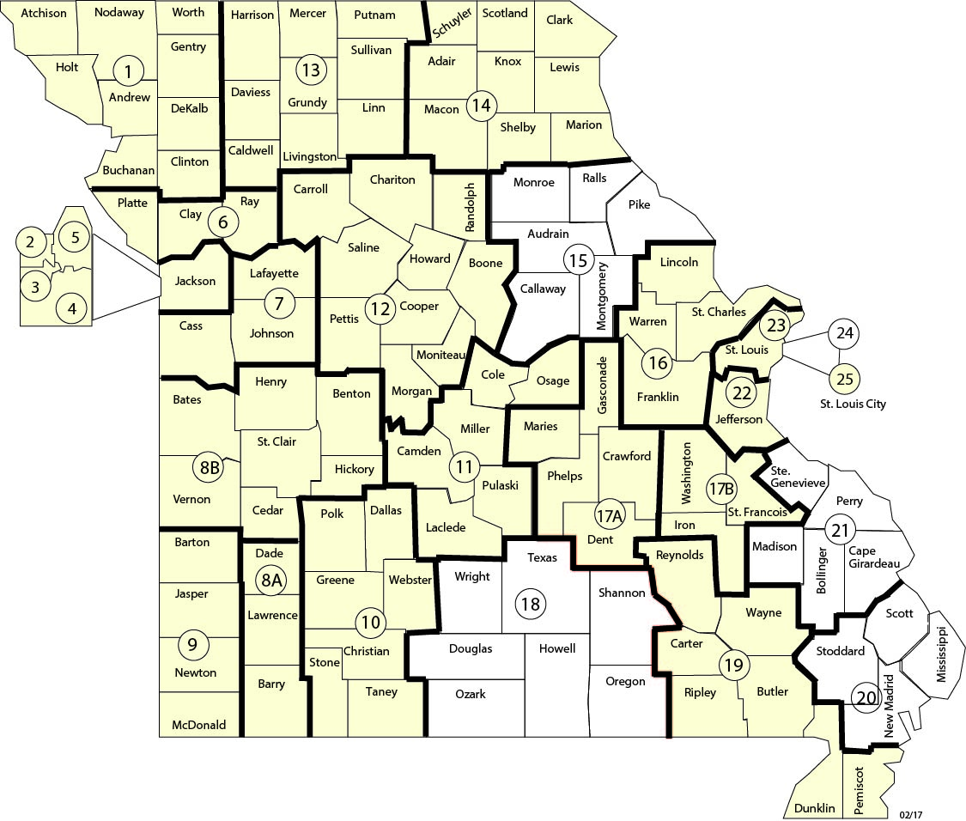
Service Areas with
Participating CCBHCs
Notes:
CCBHCs serving 22 of Missouri’s 27 service areas will be participating in the Demonstration Project.

Slide 17
Participating CCBHCs by Service Area
SA 1 – Family Guidance Center
SA 3 – Swope Health Services
SA 4 – ReDiscover
SA 5 – CMHS, Inc.
SA 6 – Tri-county MHS, Inc.
SA 7 – Pathways Behavioral Health
SA 8a – Clark CMHC
SA 8b – Pathways Behavioral Health
SA 9 – Ozark Center
SA 10 – Burrell Behavioral Health
SA 11- Pathways Behavioral Health
SA 12 – Burrell Behavioral Health
SA 13 – North Central Mo CMHC & Preferred Family Healthcare
SA 14 – Mark Twain Behavioral Health & Preferred Family Healthcare
SA 16 – Crider Center
SA 17a – Pathways Behavioral Health
SA 19 – Family Counseling Center
SA 22 – COMTREA
SA 25 –Places for People

Slide 18
Prospective Payment System (PPS)
Cost Reports document
  Actual and anticipated costs for providing CCBHC services
  Anticipated CCBHC visits
Visit
  A day in which there is at least one face-to-face encounter, or one eligible telehealth encounter, between a qualified practitioner and an eligible consumer involving the provision of a CCBHC service.
PPS Rate = Actual & Anticipated Costs/Anticipated Visits
  Cost per Visit
  No matter how many or few CCBHC services an individual receives in a given day, the CCBHC is paid the same PPS rate
Notes:
The organizations participating in the Demonstration Project completed a cost report that detailed their actual costs for providing the required CCBHC services in the past, then added any new costs that they anticipated would be incurred in order to provide the required services beginning July, 2017.
PPS payments will be based on consumer “visits”. A visit is a day in which there is at least one face-to-face encounter, or one eligible telehealth encounter, between a qualified practitioner and an eligible consumer involving the provision of a CCBHC service.
The PPS rate is based on dividing the total of the actual and anticipated costs by the number of “visits” that the organization anticipates will be provided in the state fiscal year beginning July , 2017. This yields a cost per visit which is the PPS rate. Our PPS rate is [ Insert the appropriate amount.]
Notice that only CCBHC services that are provided face-to-face ,or through telehealth count, as visits. However, the costs associated with all other services, such as case management activities without the individual present, are built into the PPS rate.
Also notice that it does not matter how many or how few CCBHC services receives in a given day, the CCBHC is paid the same PPS rate. [You may want to give an illustration: For example, the CCBHC will be paid the same rate for one consumer who sees the psychiatrist, attends PSRC, and sees their NCM on the same day, as a consumer who is visited in their home by their CSS.]

Slide 19
Pay for Performance (P4P)
Reimbursement is based on achieving specified results
Incentivizes “doing whatever it takes” to get results
Quality Bonus Payment
  Nine performance measures
  Goals
    Meet the statewide benchmark
    Show improvement over the CCBHC’s FY’16 performance
  Annual bonus payment equal to at least 1% of total PPS payments for meeting the goals
Notes:
In addition, to moving to a Prospective Payment System, Missouri is also implementing the optional Pay-for-Performance system. In a Pay-for-Performance system, providers are paid for achieving certain specified results or outcomes. This approach incentivizes innovation – doing whatever it takes to improve performance or achieving outcomes.
As part of the Demonstration Project, CCBHCs will receive a Quality Bonus Payment equal to at least 1% of the total PPS payments they received in a given year for meeting state goals related to nine performance measures. [Move to next slide.]
The goals for each performance measure will be the statewide average on that measure achieved in FY’16. CCBHCs can meet the goal for a specific measure by meeting or exceeding the statewide benchmark, which rewards good performance, or by exceeding its own FY’16 performance level, which rewards continuous improvement.
[Advance two slides forward to the slide showing movement from Fee-for-service to Prospective Payment.]

Slide 20
QBP Measures
New SUD Dependence with initiation of SUD treatment
New SUD Dependence with engagement in SUD treatment
Suicide Risk Assessment for Major Depressive Disorder(Youth)
Suicide Risk Assessment for Major Depressive Disorder (Adult)
Adherence to Antipsychotic Medication for Schizophrenia
Follow-up within 7 days post Hospitalization for MH (Adult)
Follow-up within 30 days post Hospitalization for MH (Adult)
Follow-up within 7 days post Hospitalization for MH (Youth)
Follow-up within 30 days post Hospitalization for MH (Youth)
Notes:
[This is an alternative to the previous slide.]
Here are the 9 Quality Bonus Payment measures in summary form:
Initiation of SUD treatment measures the percentage of individuals who receive some type of SUD treatment within 14 days of diagnosis.
Engagement SUD measures the percentage of individuals who receive two or more SUD services within 30 days of diagnosis
Risk assessment items measure the percentage of individuals with depression who receive a suicide risk assessment.
Of course, we already have experience in monitoring our performance with regard to the medication adherence and hospital follow-up measures.
[Return to the previous slide.]

Slide 21
CCBHC PPS
Demonstration Project
Moving from
Fee-for-Service
to
Prospective Payment
with
A Pay-for-Performance Component
Notes:
So under the Demonstration Project we are engaged in moving from a fee-for-service reimbursement system to Prospective Payment with a Pay-for-Performance component.

Slide 22
What Happens
When It’s Over?
It’s really a Pilot Program
There are Options
  New Legislation
  Medicaid Amendments and Waivers
Notes:
Ok, so we’re participating in a two-year Demonstration Project. What happens when it’s over?
First of all, we believe that this initiative is really a pilot program, not just a demonstration project. Federal and state Medicaid officials want to move away from fee-for-service payment because of its inherent incentive to provide lots of services. So this project is not so much an effort to try something to see if it will work – there is already a belief that this is a better approach. Instead it is an attempt to implement PPS on a small scale and learn from the experience before jumping in with both feet. This means that at the end of the two years there are likely to be two options.
By the end of the initiative, additional legislation may be passed mandating broader implementation of this approach. In fact, Senator Blunt came very close to securing funding to support all of the 24 states that originally applied to participate, not just the current 8. It is quite possible that by the end of the two years, all states would be required to move to a Prospective Payment System.
It should be noted that SAMHSA is also enthusiastic about promulgating the CCBHC certification criteria as the national standard for all publicly supported community behavioral healthcare organizations.
Much of what we are doing is already allowable under Medicaid rules, either through state plan amendments or waivers. If legislation hasn’t already mandated continuation of the initiative, then we’ll be able to continue through amendments and waivers.

Slide 23
Questions?

