Slide 1
Administrative Rule Reviews Executive Order 17-03 and Section 536.175, RSMo
August 2017

Slide 2
Executive Order 17-03 Administrative Rules

Slide 3
What is Executive Order 17-03 Administrative Rules Review?
On January 10, 2017, Governor Greitens issued his third executive order, Executive Order 17-03.
This order suspended all rulemaking, and among other things, ordered each state agency to undertake a review of every regulation under its jurisdiction.

Slide 4
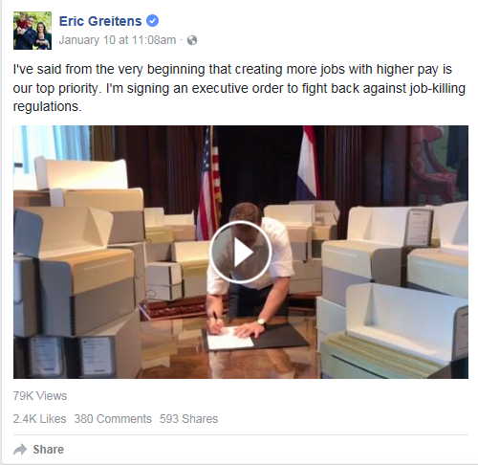
What is the Rationale Behind this Executive Order?
https://www.facebook.com/EricGreitens/videos/10154899944189747/

Slide 5
What is the Rationale Behind this Executive Order?
WHEREAS, Missouri's state government has proposed and codified an excessive amount of regulations; and
WHEREAS, the Missouri Register, a publication that includes proposed and final regulations, has published more than 40,000 pages since 2000; and
WHEREAS, Missourians and Missouri businesses deserve efficient, effective, and necessary regulations; and

Slide 6
What is the Rationale Behind this Executive Order?
WHEREAS, regulations should not reduce jobs, stifle entrepreneurship, limit innovation, or impose costs far in excess of their benefits; and
WHEREAS, regulations that are ineffective, unnecessary, or unduly burdensome must be repealed; and
WHEREAS, removing needless and burdensome regulations will make Missouri more attractive to businesses and encourage job growth.

Slide 7
What is the Schedule for EO 17-03?
There was a suspension of promulgating rules from January 10 until February 28, 2017, except for proposed regulations that affected health, safety, or welfare, or is otherwise time sensitive or required by law.
Our review process began immediately;
Our 60-day Public Comment Period is running from July 7 until September 15, 2017, and is concurrent with the Section 536.175, RSMo. It is similar to the comment process for regular rulemaking;

Slide 8
What is the Schedule for EO 17-03 (con’t)?
Two public hearings are required to be held;
All rules must be reviewed and a report completed by May 31, 2018; and
All rules that do not meet the criteria below will need to be repealed by June 30, 2018.

Slide 9
What will be in the Report?
Every agency shall answer:
How many restrictive terms are in each rule?
Includes words such as “shall,” “must,” “may not,” “prohibited,” and “required.”
DSS has 8317 restrictive words currently in its regulations. The target number is 5489.

Slide 10
What will be in the Report (con’t)?
Where did the concept of restrictive terms in regulations originate?
Mercatus Center, a think tank devoted to studying and reducing regulations out of George Mason University
https://www.mercatus.org/system/files/broughel-snapshot-missouri-regulation-2016-brief-v1.pdf
Notes:
A tool known as RegData3 —a text analysis computer program capable of scanning lengthy bodies of legal text—was developed by researchers at the Mercatus Center at George Mason University. RegData captures information in minutes that would take an ordinary person hours, weeks, or even years. For example, the tool allows researchers to identify the industries most targeted by regulation by connecting keywords relevant to those industries with restriction counts. Restrictions are words and phrases like “shall,” “must,” “may not,” “prohibited,” and “required” that signify legal constraints and obligations.

Slide 11
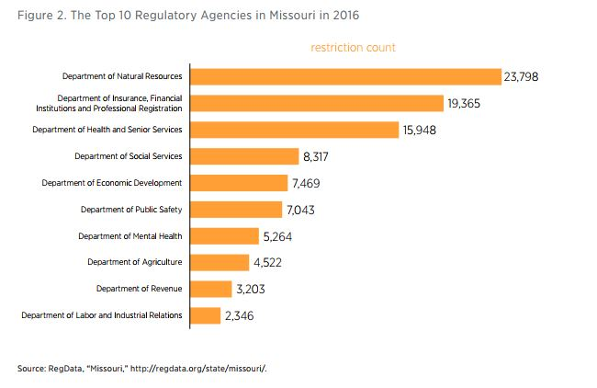
What will be in the Report (con’t)?
How does DSS rank against other state agencies? Fourth
Notes:
A tool known as RegData3 —a text analysis computer program capable of scanning lengthy bodies of legal text—was developed by researchers at the Mercatus Center at George Mason University. RegData captures information in minutes that would take an ordinary person hours, weeks, or even years. For example, the tool allows researchers to identify the industries most targeted by regulation by connecting keywords relevant to those industries with restriction counts. Restrictions are words and phrases like “shall,” “must,” “may not,” “prohibited,” and “required” that signify legal constraints and obligations.

Slide 12
What will be in the Report (con’t)?
Every agency shall answer :
Does the regulation in whole or in part, duplicate exact statutory wording?
What is the origin of rule (state, federal, etc?
If the origin is federal, is it more stringent?

Slide 13
What will be in the Report (con’t)?
Every agency shall answer :
Is the rule essential to the health, safety, and/or welfare of Missouri residents?
Do the costs of the regulation outweigh their benefits, based on a cost-benefit analysis?

Slide 14
What will be in the Report (con’t)?
Every agency shall answer :
Does a process and schedule exist to measure the effectiveness of the rule?
Have less restrictive alternatives been considered and found less desirable than the rule?

Slide 15
What will be in the Report (con’t)?
Every agency shall answer :
Is the regulation based on sound, reasonably available scientific, technical, economic, and other relevant information?
Does the regulation unduly and adversely affect Missouri citizens or customer of the State, or the competitive environment in Missouri?

Slide 16
We will also include-- Public Comment Review
An appendix will be included for rules receiving public comment
The number of comments received for each rule will be included

Slide 17
What will be in the Report (con’t)?
Every agency shall answer:
Should the rule be amended or rescinded?
Should the statute granting rulemaking authority be amended or rescinded?

Slide 18
DSS’ Process/Timeline
February 2017-June 2017
Each Division/Unit will appoint a management level employee who will be responsible for ensuring that the rule review will be completed on time and serve as a point of contact with DLS (this will be the same person as the § 536.175 review);
Each Division/Unit will be given an Excel spreadsheet to begin the review process (this will be the same file as the § 536.175 review—but a second sheet); and
Each Division/Unit will be responsible to begin review of its own regulations, based on where they are currently located (Division and Chapter)

Slide 19
DSS’ Process/Timeline (con’t)
July 7 – September 15, 2017 - Written Public Comment Period
There will be one DSS contact for the EO review — Caitlin Whaley, Legislative Director
Divisions/Units will be given the Written Public Comments and will draft responses
This section will be attached as an Appendix
The Division/Unit will summarize the Public Comment and provide a response to each Comment (this will be similar to the procedures for the Final Order of Rulemaking).

Slide 20
DSS’ Process/Timeline (con’t)
July – August 2017 – Public Hearings Held
St. Louis Thursday, July 20 Wainwright State Office Building
Springfield Wednesday, August 2 The Library Center (TLC)
Kansas City Tuesday, August 8 Kauffman Foundation Conference Center
Jefferson City Monday, August 28 Truman State Office Building

Slide 21
DSS’ Process/Timeline (con’t)
April 15, 2018
Spreadsheets and responses to Public Comment finalized.
May 31, 2018
Report Due

Slide 22
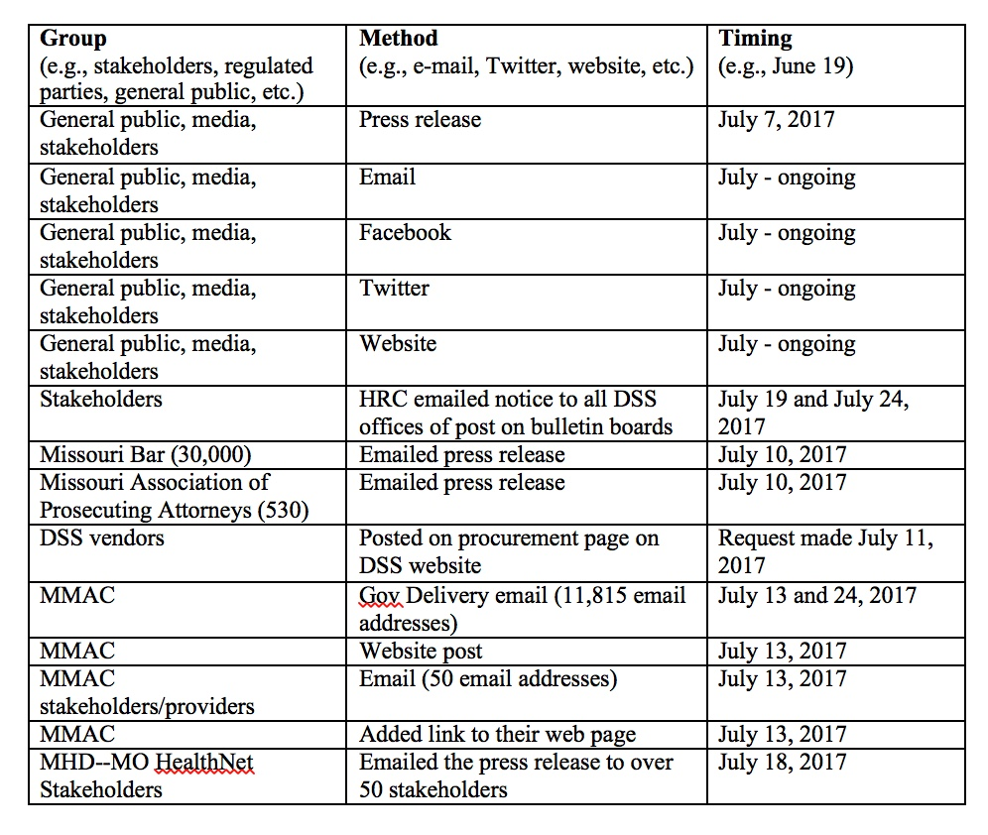
Public Outreach Plan

Slide 23
Websites/Email Address
Governor Greitens has created a special website:
Governor’s website link: https://nomoredtape.com/
DSS has created a website “Rule Tracker” to enable the public to easily provide comments to any of DSS’ rules:
Department website link: https://dssruletracker.mo.gov/dss-proposed-rules/welcome.action#OPEN
DSS has created a special email address to receive comments:
Department email address: Rules.Comment@dss.mo.gov

Slide 24
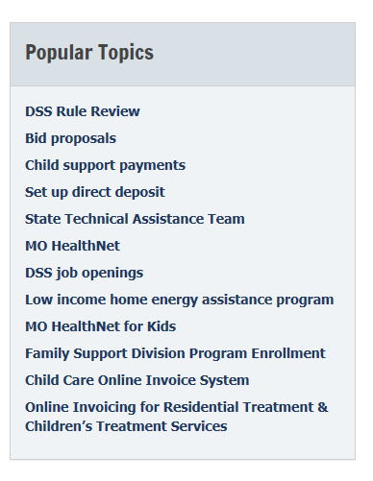
Rule Tracker
DSS’ Home Page

Slide 25
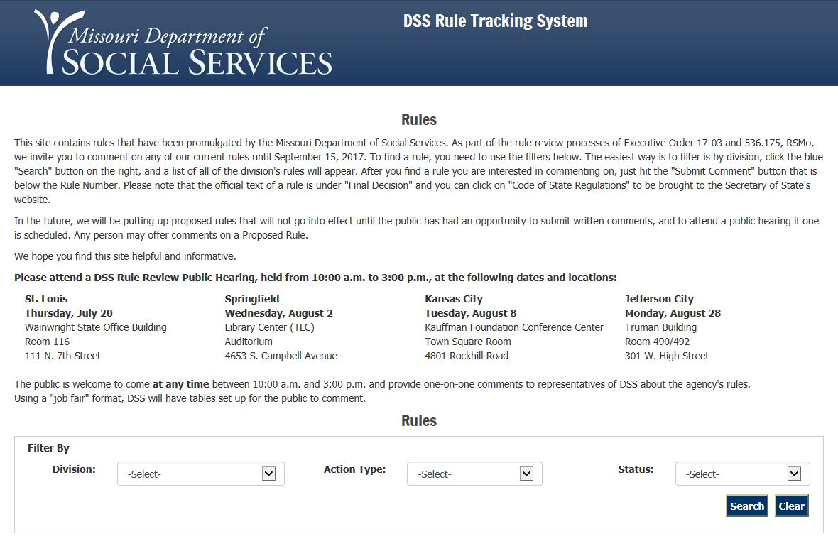
Rule Tracker (con’t)

Slide 26
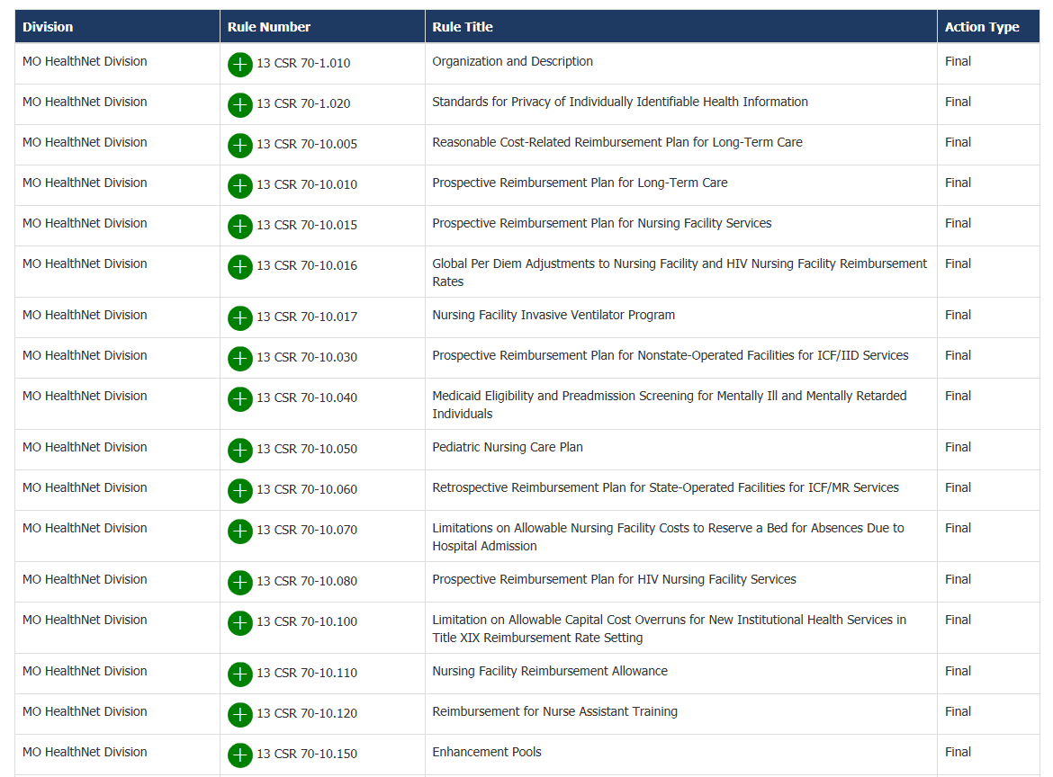
Rule Tracker (con’t)

Slide 27
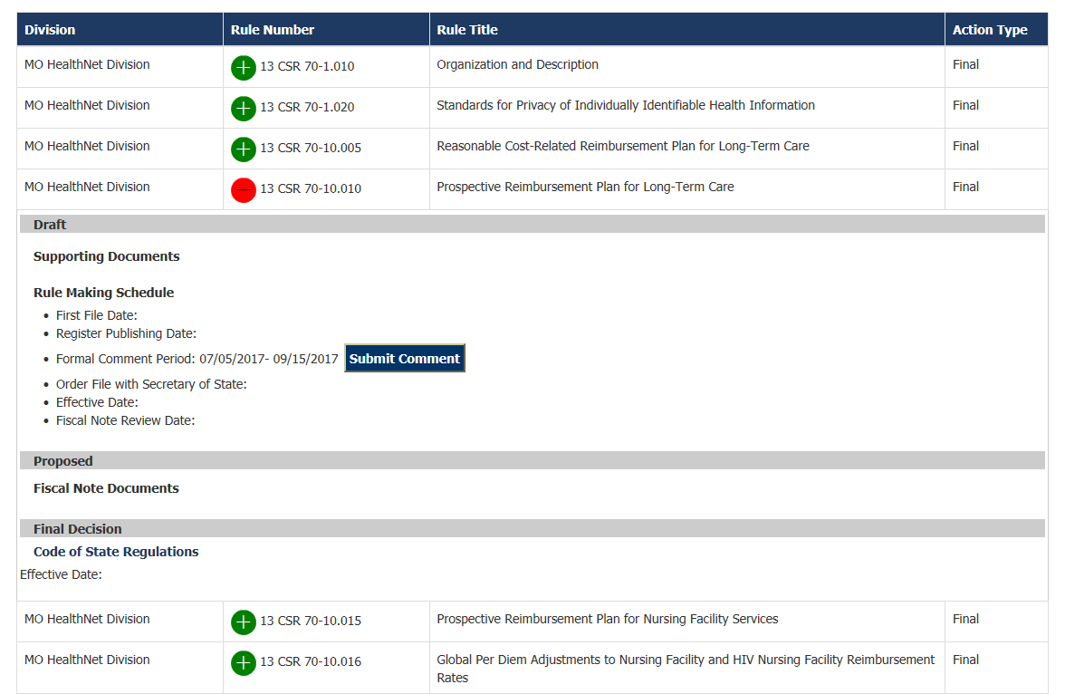
Rule Tracker (con’t)

Slide 28
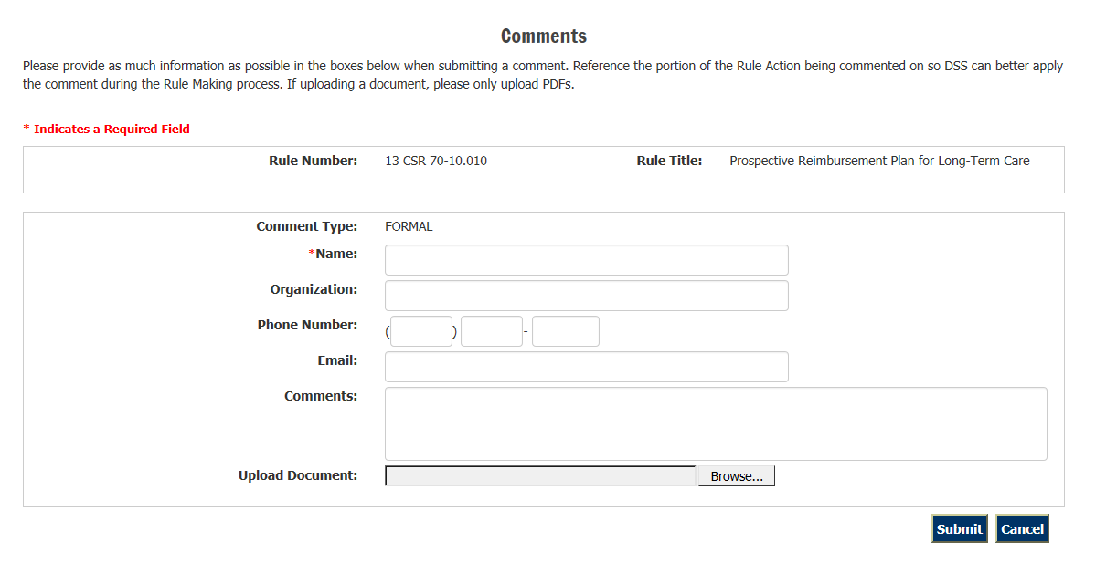
Rule Tracker (con’t)

Slide 29
§ 536.175, RSMo, Administrative Rules

Slide 30
What is § 536.175, RSMo, Administrative Rules Review?
The legislature promulgated § 536.175, RSMo, in 2012
The statute requires that “[e]ach state agency shall periodically review all of its rules” according to a set schedule and set criteria

Slide 31
What is the Schedule for the Department of Social Services?
DSS was required to begin its review process no later than July 1, 2017 (§ 536.175.1(3)).
On July 1, 2017, notice was published in the Missouri Register stating that DSS’ regulations are now subject to public comment.
The public comment period runs from July 1, 2017 to August 30, 2017, and will be similar to the comment process for regular rulemaking.
DSS must file a report with the Joint Committee on Administrative Rules (JCAR) and the Small Business Regulatory Fairness Board no later than June 30, 2018. DSS must also post it on its website.

Slide 32
What will be in the Report?
There are two main components to the report:
Rule review
Public comment review

Slide 33
What will be in the Report (con’t)?
Rule review: § 536.175.4, RSMo, requires state agencies to review all existing regulations under the following criteria:
Whether the rule is necessary;
Whether the rule is obsolete;
Whether the rule overlaps, duplicates, or conflicts with another rule;
Whether less a restrictive or more narrowly tailored rule is appropriate;
Whether the rule can be modified to reduce regulatory burden or eliminate paperwork;
Whether there is a need for amendment or rescission;
Whether incorporated material is still relevant; and
If effect on small business is still relevant.

Slide 34
What will be in the Report? Public Comment Review
§ 536.175.4(8), RSMo, requires state agencies to review the public comments received during the Public Comment period.
An appendix will also be included that will contain the nature of the comments received on the rules and DSS’ responses to the comments.

Slide 35
What Happens if We Do Not Comply?
If DSS fails to comply, either by failing to file the report on time, or by neglecting to including all of our rules, what are the potential outcomes?
Section 536.175, RSMo, specifically says that if we fail to file our report by the required deadline without good cause, or neglect to include all of our rules, all or those individual rules may become null and void.

Slide 36
DSS’ Process/Timeline
February-June 2017
Each Division/Unit will be given an Excel spreadsheet to begin the review process.
Each Division/Unit will be responsible for its own regulations, based on where they are currently located (Division and Chapter).
If we are in the process of moving regulations from one Division/Chapter to another, the new “owner” of the regulation would only be responsible for the regulation if an Amendment or In Addition has been filed with the Secretary of State’s Office and JCAR to effect that change.

Slide 37
DSS’ Process/Timeline
July 2017-May 2018
There will be one DSS contact for the Public Comments. That will be Peggy Landwehr.
Divisions/Units will collect Public Comments and draft responses.
Divisions/Units will review their spreadsheets to ensure they are current and turn into Peggy Landwehr by May 15, 2018.
June 30, 2018
Report Due

Slide 38
Questions?
Please feel free to call or e-mail Caitlin Whaley regarding the EO 17-03 Review at 573-751-4815 or Caitlin.Whaley@dss.mo.gov
Please feel free to call or e-mail Peggy Landwehr regarding the Section 536.175, RSMo, review at 573-522-8368 or Peggy. Landwehr@dss.mo.gov

