Slide 1
Presumptive Eligibility (PE)
Everything a health care provider needs to know about PE

Slide 2
What is Presumptive Eligibility?
Presumptive Eligibility makes it possible for eligible individuals to gain immediate access to medical services for a temporary period of time while they submit an application to be processed for on-going Medicaid coverage.

Slide 3
What is Presumptive Eligibility?
PE ensures providers will be reimbursed for services provided if such services are included in the benefit package.

Slide 4
PE programs available
Temporary MO HealthNet During Pregnancy (TEMP) has been available since 1990
PE for children ages 0-18 has been available since 2003
Show-Me Healthy Babies-PE (SMHB-PE) has been available since January 2016
PE for Parents/Caretaker Relatives and Former Foster Care Youth has been available since October 2016

Slide 5
PE programs available
There is also Breast and Cervical Cancer Treatment PE. This program is administered by and determinations made by Show-Me Healthy Women Providers.
For additional information, go to:
https://mydss.mo.gov/healthcare/breast-or-cervical-cancer-treatment-program

Slide 6
PE Benefits
The following groups receive full MO HealthNet Coverage for a temporary period of time under PE:
Children,
Breast and Cervical Cancer enrollees,
Parents/Caretaker Relatives, and
Former Foster Care Youth

Slide 7
PE Benefits
Pregnant women receive only ambulatory pre-natal services provided on an outpatient basis.
Ambulatory prenatal care services are limited to the following services while the individual is pregnant:
physician/clinic, nurse-midwife, diagnostic, x-ray and lab, pharmacy and outpatient hospital services.
It does not cover the individual if she is no longer pregnant. The following, and any other services which are not Ambulatory Prenatal Services, are not covered:
Delivery, D&C’s, inpatient hospital, dental, or optical.

Slide 8
Who makes PE determinations?
The Family Support Division (FSD) trains eligible health care providers to serve as Qualified Entities (QE) and make PE determinations.
QEs in Missouri are primarily:
Local Public Health Agencies (City and County Health Departments);
Federally Qualified Health Centers and Rural Health Centers; and
Hospitals and their affiliated clinics.
Decisions made by QEs are final. There is no appeal process for PE applicants.

Slide 9
What proof of eligibility is provided to applicants who are approved for PE?
Upon approval, QEs provide approved applicants with one of the following paper forms that indicate they are approved:
MO HealthNet Presumptive Eligibility Authorization (PE-3) is used only for children, former foster care youth, and parents/caretaker relatives.
MO HealthNet TEMP/SMHB-PE Authorization (PE-3 TEMP/SMHBPE) is only used for pregnant women.

Slide 10
What proof of eligibility is provided to successful applicants?
If a patient presents a provider with a PE-3 or PE-3 TEMP the provider can bill for Medicaid services provided to the patient if such services are included in Medicaid’s benefit package.
Eligibility is not immediately entered in the MO HealthNet system. The forms; however, are valid once issued.

Slide 11
MO HealthNet Presumptive Eligibility Authorization Form/PE-3 (Used for children, former foster care youth, and parents/caretaker relatives)

Slide 12
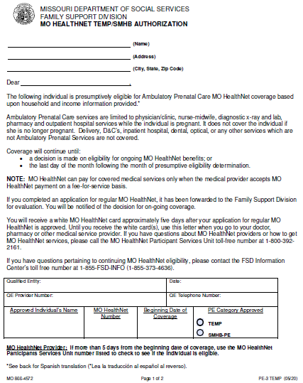
MO HealthNet TEMP/SMHB-PE Authorization Form/PE-3 TEMP/SMHBPE (Used for pregnant women)

Slide 13
What is required to bill MO HealthNet for services provided to PE clients?
You need to be enrolled as a MO HealthNet fee-for-service provider in order to bill Medicaid for services provided to patients with PE coverage.
Payments for services provided to patients with PE coverage will be paid through MO HealthNet Division’s fee-for-service program at fee-for-service rates.

Slide 14
Will the person given PE be eligible for on-going Medicaid coverage?
PE Applicants complete an application (PE–1SSL) used only for PE coverage. The PE –1SSL is not an application for on-going Medicaid coverage. PE recipients must also apply for full MO HealthNet coverage.
In most cases your patients who have been approved for PE will also be approved for on-going Medicaid coverage.
QEs use the same income standards for PE determinations as are used to make full Medicaid determinations. They accept the applicant’s statement on PE applications and are not required to verify any information.
FSD caseworkers are required to verify certain things, including income. In some cases individuals are determined eligible for PE who may not be determined eligible for on-going Medicaid coverage.

Slide 15
How do people approved for PE apply for full, on-going MO HealthNet coverage?
Qualified Entities are required to assist PE applicants in preparing and submitting applications for on-going MO HealthNet coverage.
If you have a patient who has been approved for PE, inquire if they have applied for on-going MO HealthNet
If they have not applied yet, encourage them to apply before their PE coverage runs out.

Slide 16
How do people approved for PE apply for full, on-going MO HealthNet coverage?
Ways to apply at: https://mydss.mo.gov/healthcare/apply
Through the online portal
By calling 855-373-9994;
Complete an application and submit it:
Email: FSD.Documents@dss.mo.gov
Mail: 615 E 13th St, Kansas City MO 64106
Fax: 573-526-9400

Slide 17
It is important to get PE recipients enrolled in on-going MO HealthNet
PE is active until the end of the month following the month of application.
Pregnant women are only entitled to one period of PE during a pregnancy.
Children, Parents, Caretaker Relatives and Former Foster Care Youth are only entitled to one period of PE during a 12-month period.
Therefore, it is important to encourage PE recipients to submit an application for on-going MO HealthNet coverage if they haven’t already.

Slide 18
Summary
You need to be enrolled as a MO HealthNet fee-for-service provider in order to bill MO HealthNet for services provided to patients with PE coverage.
Payments for services provided to patients with PE coverage will be paid through MHD’s fee-for-service program at fee-for-service rates.

Slide 19
Summary
The PE-3 and PE-3 TEMP forms presented to you by your patient serve as proof of eligibility. Since the coverage does not show up immediately in eMOMED, you can monitor eMOMED for a few days to see if the coverage is entered in that system.
When billing Medicaid for services provided to PE patients, providers are instructed to make a copy of the PE-3 and PE-3TEMP forms. As long as the date you provide a service is within the dates on the PE-3 and PE- 3 TEMP forms MO HealthNet will guarantee reimbursement.

